Slide 1

UI and UX DESIGN Creating beautiful and user –friendly Digital Experiences
🎨Attractive 👆Easy to use 😊User
Design Experience Satisfaction

Slide 2

-UI EXAMPLE
UI means how an application looks
FEATURES
Drag & Drop
Templates
Fonts
Photo Editing
When we open Canva, we can see colourful buttons, menus, icons, and templates. Everything is arranged neatly, so users can easily create posters, presentations, and social media designs.
UI HIGHLIGHTS
Attractive colours
Clean layout
Easy Buttons

Slide 3

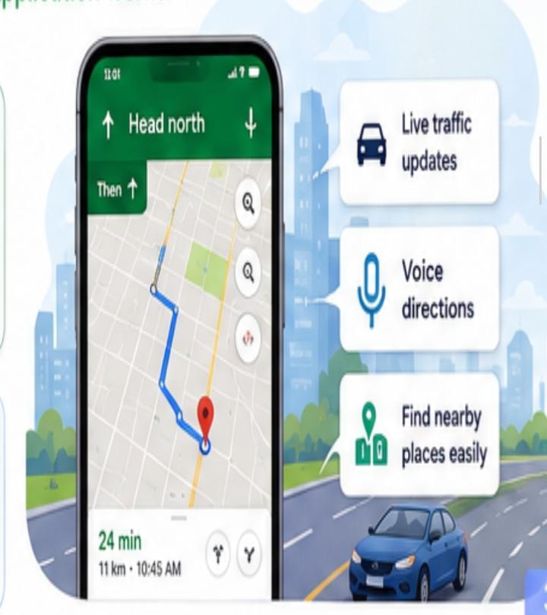
G Google Maps-UX Example
UX means How an application Works
FEATURES
GPS Navigation
Live Traffic
Voice Direction
Nearby Places
UX Highlights
Easy to navigate
Fast Routers
Smooth Experience

Slide 4
UI (User interface)
UX (user Experience
Focus on appearance
Visual Design
Colours &Layout
Typography
Attractive Element
Focus on Experience
Easy Navigation
User Satisfaction
Problem solving
Smooth interaction
UI=How it Looks | UX=How Works

Slide 5


Key points
UI attracts users
UX keeps users happy
Both UI &UX are important for successful digital products
EXAMPLES
UI Example Canva
UX Example Google Maps
THANK YOU !
Good UI attracts users ,
Great UX keeps them coming back

